Slide 2
IBM Cloud 架構設計說明
IBM Cloud Unit
雲端專家
馮建國 (Gordon)

Slide 4
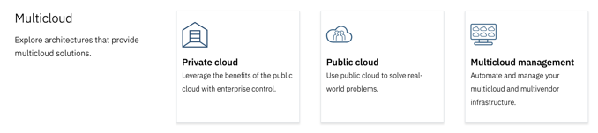
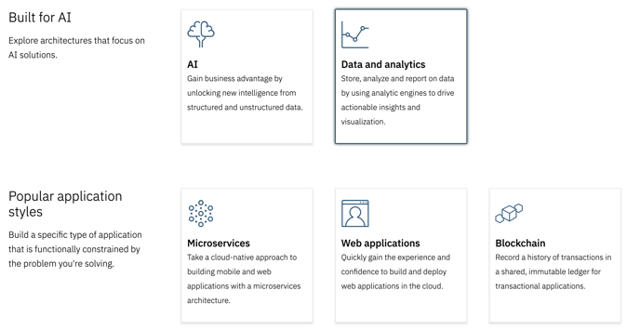
IBM Architecture center
https://www.ibm.com/cloud/garage/architectures

Slide 5
USERS & OTHER SERVICES
IBM CLOUD
ENTERPRISE
Platform Management
Asset Services
Cloud
Management
DASHBOARD
CLOUD
MANAGEMENT
ANALYTICS
IDENTITY
KEYS
IP
CERTIFICATES
SSH
LOGGING
Storage & Data
Runtime Management
CLOUD
MESSAGING
END
USER
END
USER
DATA
STORES
FILE
BLOCK
OBJECT
PROVISION
EVENTS
CONTAINER MANAGEMENT
AUTO SCALING
MONITORING
ENTERPRISE
DATA
EDGE
SERVICES
TRANSFORMATION &
CONNECTIVITY
Compute & Run Time
Connectivity
NOTIFICATION
ENTERPRISE
SERVICES
OTHER CLOUD SERVICES
VIRTUAL INFRASTRUCTURE
CONTAINERS
BARE METAL SERVERS
FIREWALL
VIRTUAL CLOUD
NETWORK
ROUTING SERVICES
BACKUP/DR
Security
EXISTING
ENTERPRISE
SYSTEMS
TRANSPORT SECURITY
IDENTITY & ACCESS MANAGEMENT
DATA SECURITY
NETWORK SECURITY
APPLICATION SECUIRTY
SECURITY VISIBILITY

Slide 6




Advanced Web application basic reference architecture
PUBLIC NETWORK
CLOUD PROVIDER
ENTERPRISE NETWORK
1
2
6
USER
CORE
APPLICATION
3
DATA
STORE
LEGEND
4
5
Application
Infrastructure
Data Store
Security
Users
NETWORK
SECURITY

Slide 7




Advanced Web application advanced reference architecture
PUBLIC NETWORK
CLOUD PROVIDER
ENTERPRISE NETWORK
USER
DIRECTORY
4
1
2
3
7
11
USER
EDGE
SERVICES
CORE
APPLICATION
TRANSFORMATION &
CONNECTIVITY
ENTERPRISE
APPLICATION
6
8
5
4
ENTERPRISE
DATA
CACHES
DATA
STORE
USER
DIRECTORY
LEGEND
9
10
Application
Infrastructure
Data Store
Security
Users
NETWORK
SECURITY

Slide 8
IBM Cloud VPC Overview

